Slide 1
Investigative Research: Public Records and “Publicly Available Information
Sue Altmeyer, J.D., M.L.S.
Electronic Services Librarian, Cleveland Marshall College of Law
Nov 11, 2011

Slide 2
Research Guide
C|M|LAW guide – Public Records and People Finders

Slide 3
What is available?
Only public records.
See ORC 149.43
Some items excluded :
▪ medical records
▪ probation records
▪ adoption records
▪ confidential law enforcement
investigatory records

Slide 4
FOIA Limits
Federal government will not disclose
▪ national defense info
▪ personal and medical info
▪ ongoing law enforcement investigations and confidential sources
▪ certain geological info
▪ information exempt under federal law
See 5 USC 552(b)., (FOIA)

Slide 5
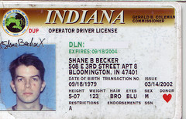
Statutes limiting access
Driver’s Privacy Protection Act,18 USC 2721
Fair Credit Reporting Act, 15 USC 1681 et seq. – applies when obtaining information from a seller of “consumer reports”
Image: 'My Second Driver's License' www.flickr.com/photos/15914631@ N00/3348033929
Notes:
Driver’s Privacy Protection Act – need a permissible purpose to access driver’s license information. Civil or Criminal investigation is a permissible purpose.
Requires that a “consumer report” gathered by anyone regularly involved in the business of compiling and selling consumer reports (“consumer reporting agency”) can only be disclosed to those who have a permissible use.

Slide 6
Fair Credit Reporting Act
Outside FCRA – Info not created or used for credit eligibility, insurance, employment or licensing, or expected to be used for these purposes.
Criminal records etc on Lexis, WL to be used for civil/criminal case = NON-FCRA
Permissible Use: Collection on Accounts

Slide 7
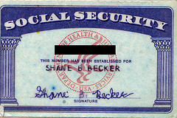
Social Security No. protection
Ohio 127th GA SB 6 (R.C. 149.45(B))
Social Security Number Protection Act of 2010, (S. 3789) Public Law No: 111-318
Bill to prohibit sale: Protecting the Privacy of Social Security Numbers Act of 2009 – did not pass
PENDING Identity Theft Prevention Act of 2011
Image: 'My First Social Security Card' www.flickr.com/photos/15914631@ N00/3348033925
Notes:
Intelligence Reform and Terrorism Prevention Act of 2004 (Can not put social security number on driver’s license) 42 U.S.C.A. §405c(2)C(vi)(II)
Image: 'My First Social Security Card‘
prohibit the commercial sale of SSNs .) These bills contain exceptions, including an exception for employee background checks, fraud prevention. mends the federal criminal code to prohibit the display, sale, or purchase of Social Security numbers without the affirmatively expressed consent of the individual, except in specified circumstances. Directs the Attorney General to study and report to Congress on all the uses of Social Security numbers permitted, required, authorized, or excepted under any federal law, including the impact of such uses on privacy and data security.
Establishes a public records exception to the prohibition. Directs the Comptroller General to study and report to Congress on Social Security numbers in public records. Grants the Attorney General rulemaking authority to enforce this Act's prohibition and to implement and clarify the permitted uses occurring as a result of an interaction between businesses, governments, or business and government. Prohibits a commercial entity from requiring an individual to provide a Social Security number when purchasing a commercial good or service or denying an individual the good or service for refusing to provide that number, with exceptions. Establishes civil and criminal penalties.
Extends civil monetary penalties for misuse of a Social Security number.
Provides for: (1) criminal penalties under SSA title II for the misuse of a Social Security number; (2) civil actions and civil penalties against persons who violate this Act; and (3) federal injunctive authority with respect to any violation by a public entity. www.flickr.com/photos/15914631@ N00/3348033925
Ohio S.B. 6 prohibits a public office from making available to the general public on the Internet any document that contains an individual's Social Security number. (R.C. 149.45(B)(1) and (2))

Slide 8
Gramm Leach Bliley
Compiler of records obtains info from credit bureaus or other "financial institutions“
What You Should Know About LexisNexis Person Locator Products and the Gramm Leach Bliley Act - permissible uses

Slide 9
Ohio Superintendence Rules
Court policies Superintendence Rules 44-47, effective July 1, 2009
parties who file documents are responsible for redacting "personal identifiers”
Notes:
Provide for partial redaction or omission of social security numbers and other identifying information.
Provide that a party to a case, or person whom the information is about, may request that the court limit access to case information. The court can limit public access, if it finds that the presumption of allowing public access is outweighed by a higher interest" after considering a list of four factors. The court must use the least restrictive means of limiting access.
Create a procedure where any person can request access to documents or information that has been granted "limited public access".

Slide 10
Restrictions on Accessing
Public records may not be published or readily available – may have to do information request.

Slide 11
Is “free background check” on the Web possible?
Only to a certain extent.
Free materials on-line = discrete bits of information. Pay databases retrieve information from many sources.
Not every court/government agency makes records available via Web.

Slide 12
For Fee Databases
Westlaw & LexisNexis
Accurint signup is free –pay per search.
Openonline -minimal set-up fee and annual cost, pay per search.
Other reputable fee services include: Choicepoint, KnowX.com, 1800US Search.com, NetDetective.net, SearchSystems.com.

Slide 13
Important Tips
Cross-check results among multiple databases or websites to ensure accuracy.
Check the coverage of the database. How far does it go back ? What states or counties are included?

Slide 14
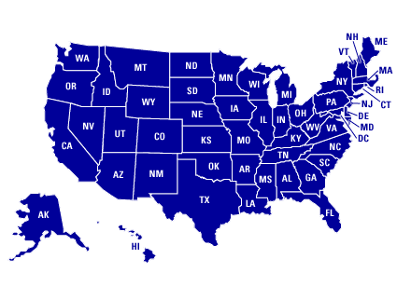
Starting Points and Portals
Comprehensive reports - Lexis, Accurint, Westlaw
Cleveland Marshall’s Public Records Research Guide
Netronline
SearchSystems.net
PublicRecords.com
BRB Publications
People Ferret (includes
military)

Slide 17
Professional Licenses
Whether licensed, but not necessarily in good standing, ex. Ohio Supreme Court – Attorney Information Search
Year licensed
Disciplinary action
Business address/phone
Image: 'kitty loves teeth need checked' www.flickr.com/photos/25159787@N07/2518022484
Notes:
Professional license information can reveal a person’s business address, whether they are currently licensed and whether they have been subject to disciplinary action by the governing bodies of their profession.

Slide 18
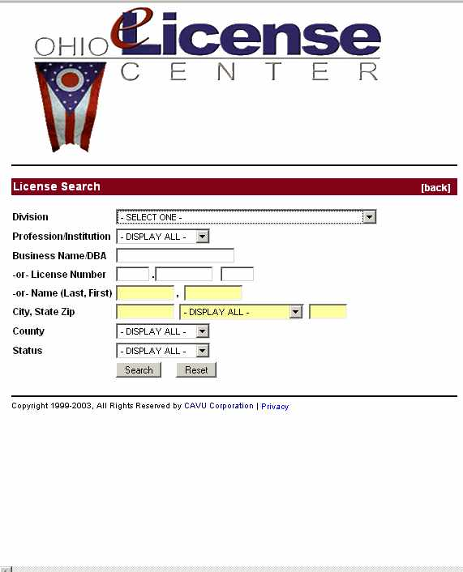

Slide 19
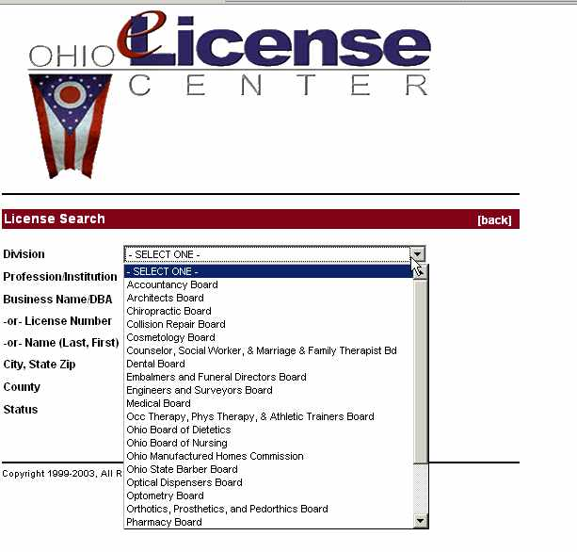

Slide 20
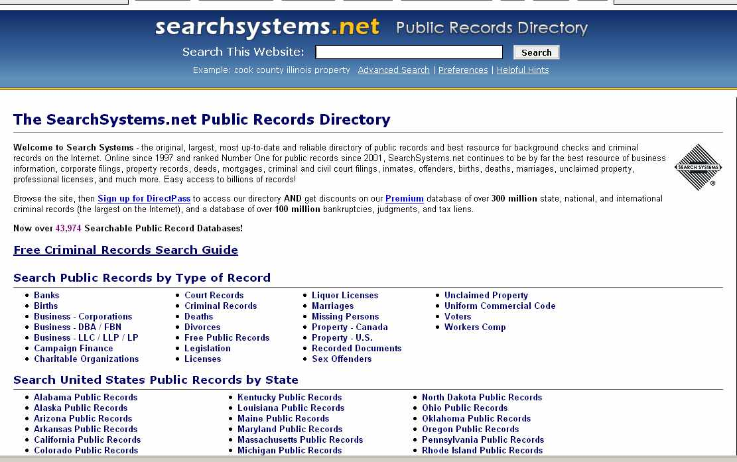

Slide 24
Notes:
Does not indicate whether the person has been sanctioned by the Supreme Court pursuant to Gov. Bar R. VI (registration & registration fee) or Gov. Bar R. X (continuing legal education).

Slide 25
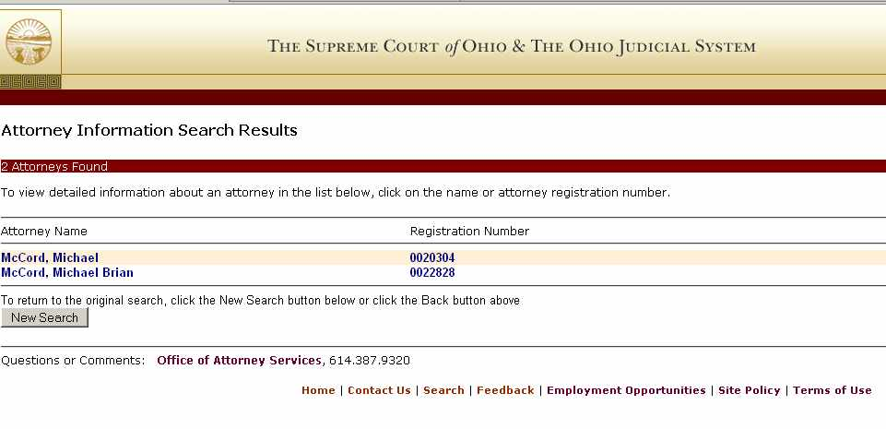

Slide 26
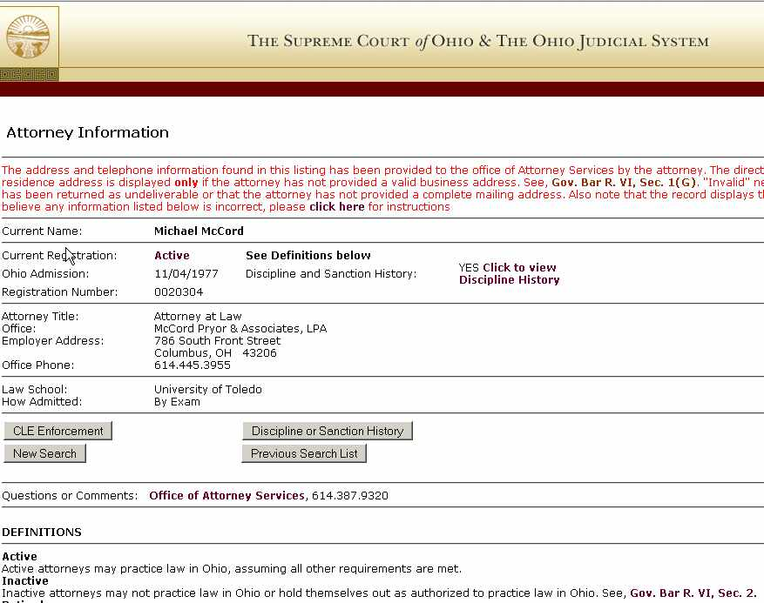

Slide 27
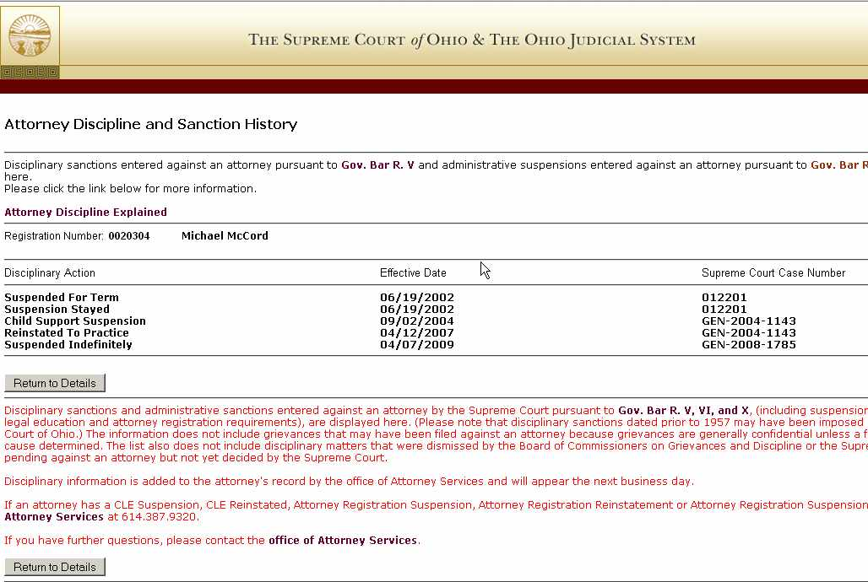

Slide 28
Attorney Licenses
A Compilation of State Lawyer Licensing Databases
Ohio Supreme Court cases -disciplinary cases, 1993-
ABA - Directory of Lawyer Disciplinary Agencies

Slide 29
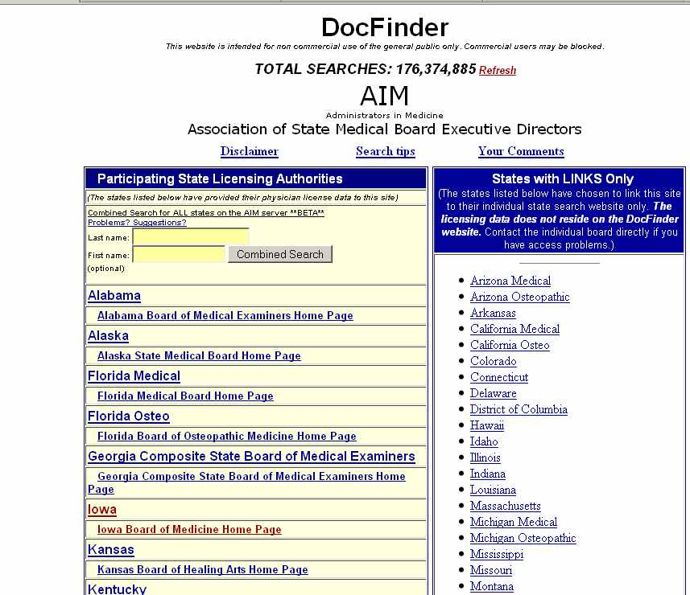

Slide 30
State Medical Board of Ohio
http://www.med.ohio.gov/professional.htm
Refers back to Ohio License Center

Slide 31
Stock Brokers & Advisors
Zimmerman’s Research Guide – broker's Form BD
News articles, google
FINRA Broker Check
NYSE Arbitration Decisions – 2000-
FINRA Arbitration Awards Online 1988-
SEC - Check Out Brokers and Advisors (article)
Notes:
SEC - Links for finding out whether investment professionals are licensed by the state or federal government and whether they have had run-ins with regulators or serious complaints from investors. Information on firms and brokers.
FINRA - Check the professional background of current and former FINRA-registered securities firms and brokers. FINRA is a non-government regulator of securities firms.

Slide 32
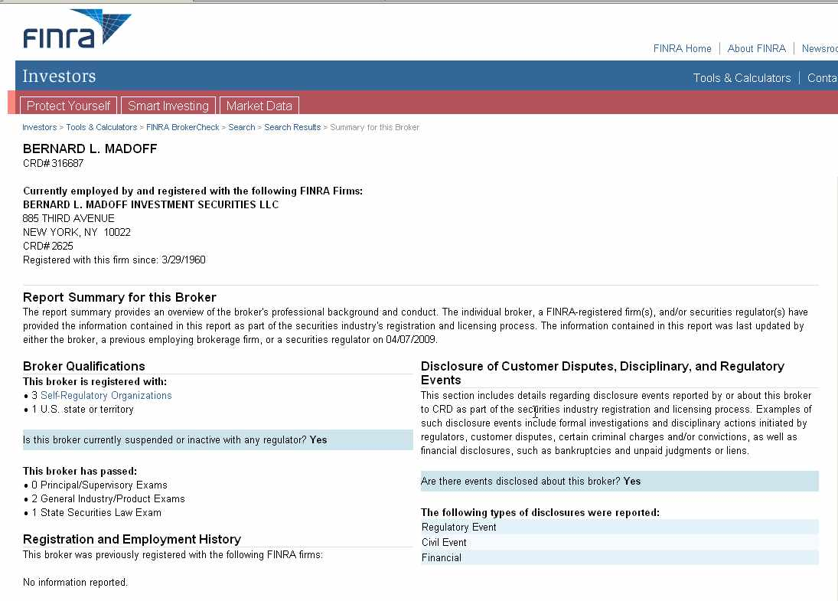
Notes:
See Disclosure section --- He was indicted, but the site is 30 days behind

Slide 34
Stock Brokers
National Futures Association's Background Affiliation Status Information Center (BASIC).
NYSE Disciplinary Actions – Gruttadauria
Certified Financial Planner Look-up
Notes:
Certified Financial Planner - Find financial planners certified by the Certified Financial Planner Board of Standards, Inc. and whether there has been disciplinary action by the Board. This database DOES NOT indicate whether the planner holds required federal or state licenses.
Philip Rossi
Bernard Madoff

Slide 35
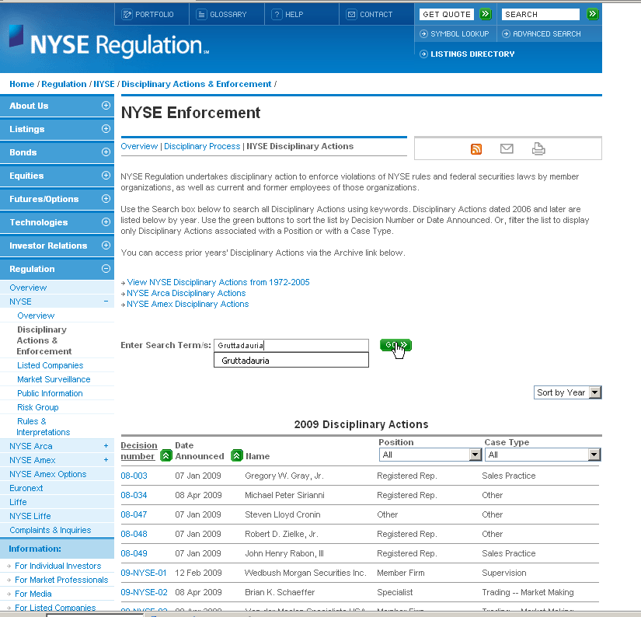

Slide 36
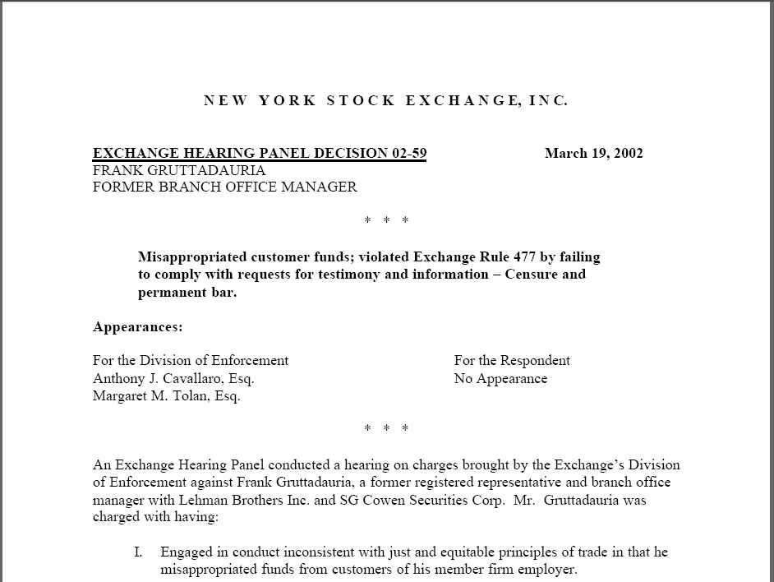

Slide 37
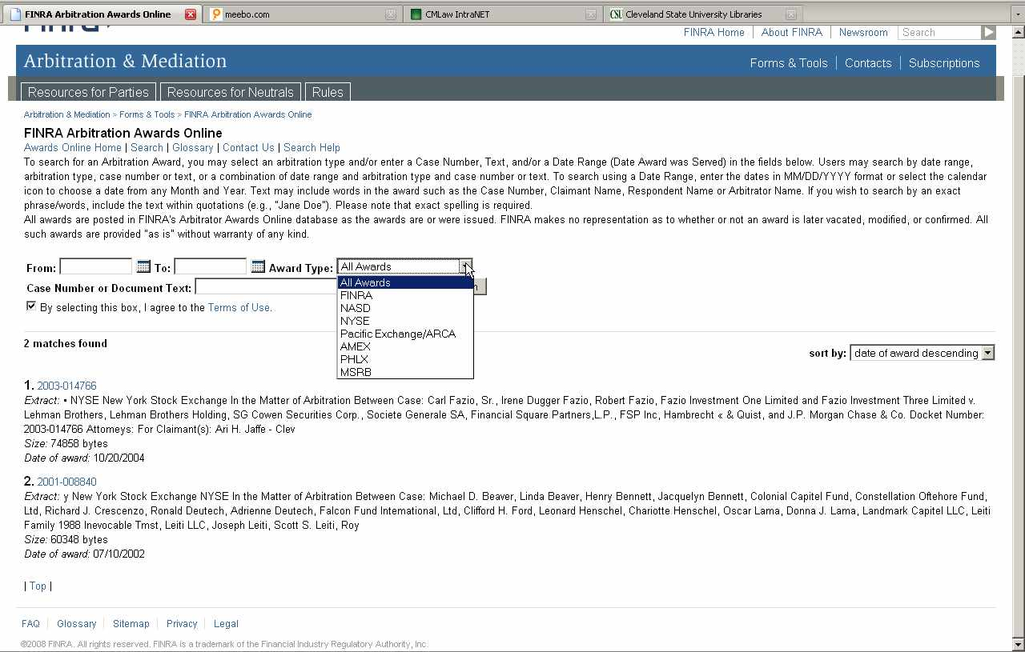

Slide 38
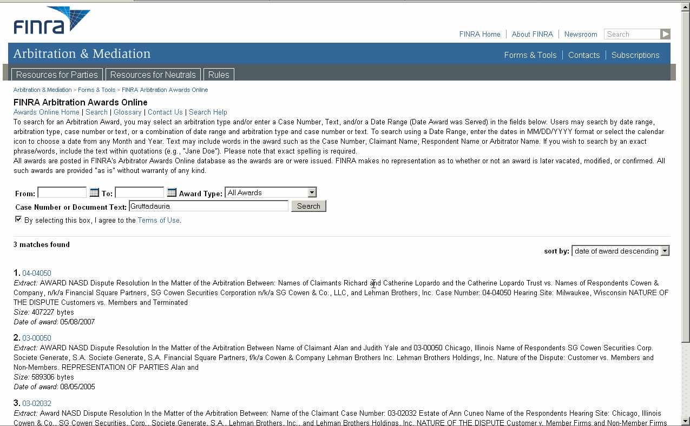

Slide 39
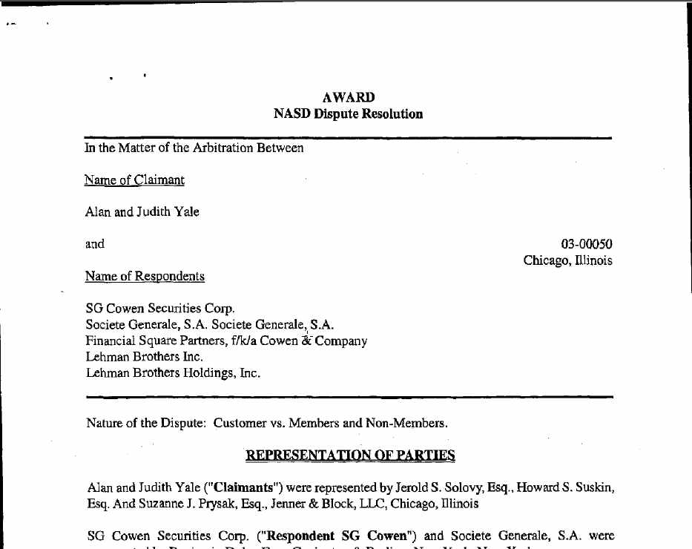

Slide 40
Accountants
http://www.aicpa.org/forthepublic/disciplinaryactions/pages/default.aspx

Slide 41
Criminal Records
So-called "national" databases inaccessible to non-governmental users.
See “National Criminal Background Checks: Myths, Realities & Resources” by Jackie Walters.
Pay databases– LexisNexis, Westlaw, Openonline and Accurint may not pick up misdemeanors or all arrests. Examine scope of database before pay to search it.

Slide 42
Criminal Records
Cuyahoga County felony arrest records can be obtained at the County Sheriff’s office. Cost = $6.00. Back to early 1970s.
www.buckeyesheriffs.org for other Sheriff’s offices
Do docket search of individual courts.

Slide 43
Criminal Records – Free Web
Criminalsearches.com: Searches across numerous states and counties. May not include all courts/counties. Appears to includes Cuyahoga, not Summit.
Federal Bureau of Prisons (Incarcerated 1982 to present. Minimal info.)
Ohio Dept of Corrections Offenders sentenced to serve time in a STATE facility.
Corrections.com – Links to other states’ databases.
Policereports.us

Slide 44
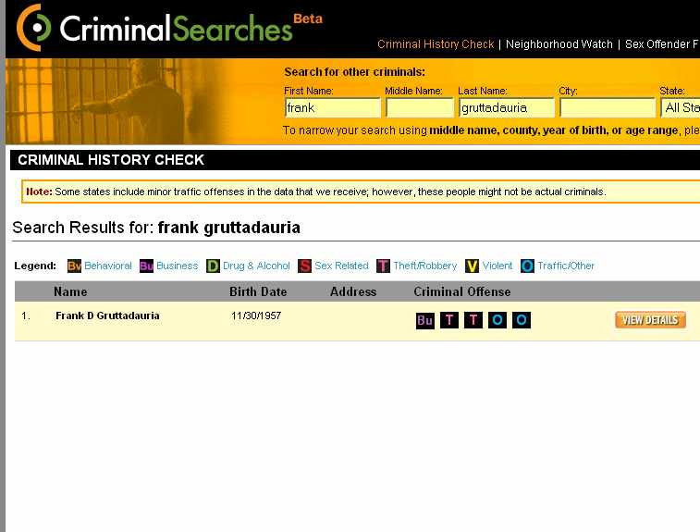

Slide 45
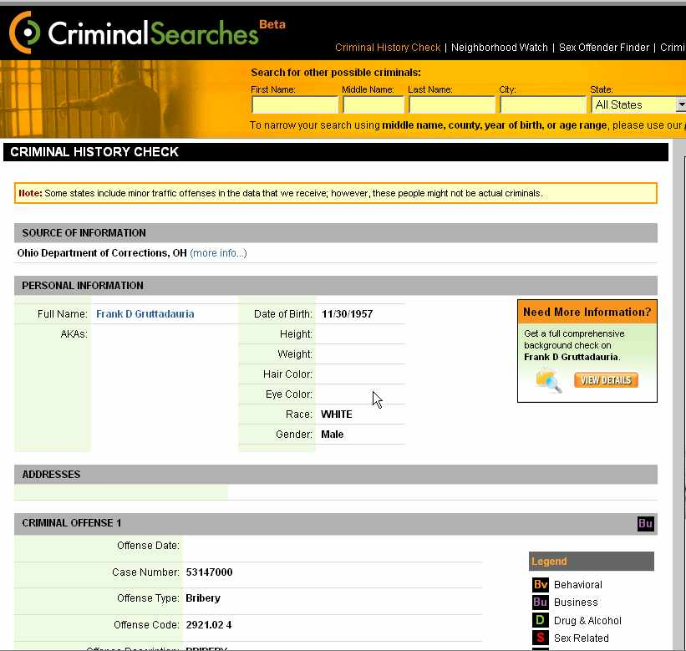

Slide 46
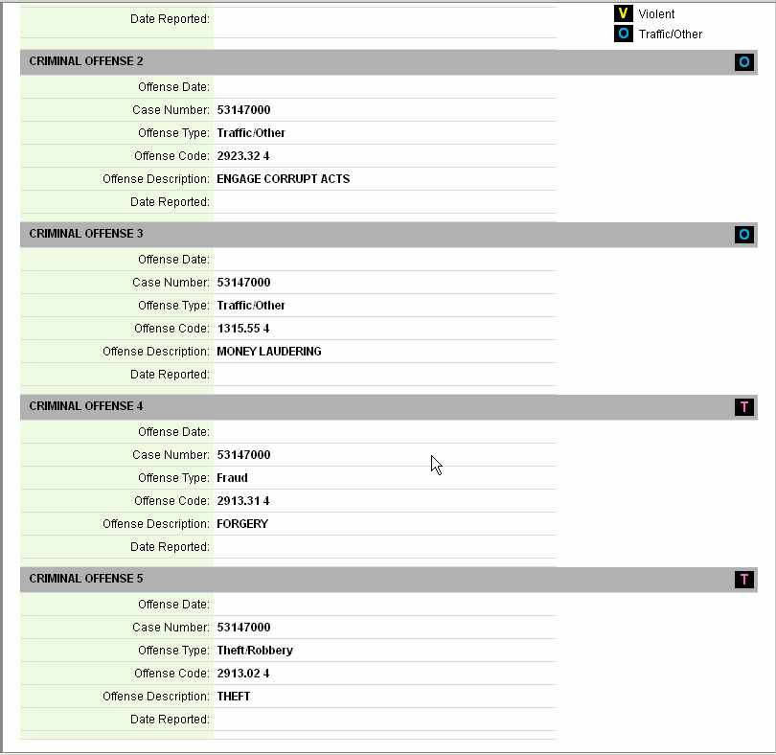

Slide 47
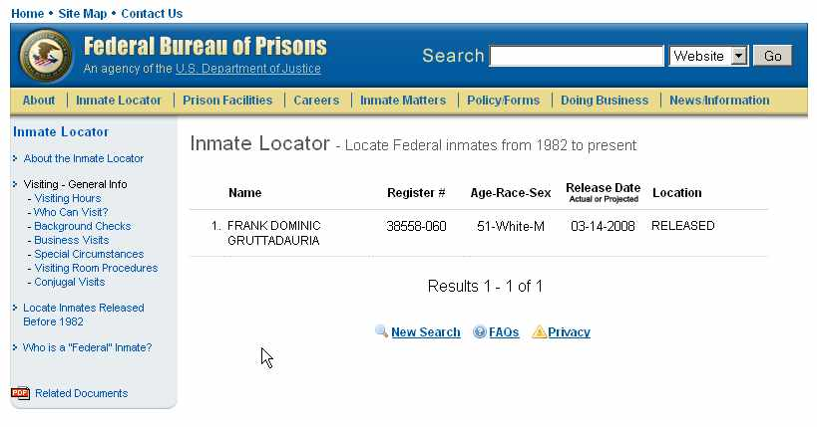

Slide 48
Sex offender databases
National Sex Offender Public Registry: Searches multiple state databases
FBI's State Sex Offender Registries: Links to state databases.
Family Watchdog - Find offenders nationwide by street or offender name.

Slide 49
Criminal Records
Newspapers, Court Dockets.
BMV records, if permissible purpose.
Notes:
For fee, need fingerprints and driver’s license. Arrests for felonies and escalating misdemeanors.

Slide 50
Vital Records –Birth/Death
National Center for Health Statistics
Ohio Department of Health – order online or info on local offices’ Web sites. Birth 1908-, Death 1954-
Summit County Probate has birth/death 1867- 1908
Notes:
. Order online or find the location of local offices where you can obtain copies. For example, Cleveland City Hall is one such local office.

Slide 51
Death Records
Ohio Historical Society, Death Certificate Index , some older birth records
Cleveland Necrology File 1850-1975
Social Security Death Index
Americas Obituaries and Death Notices (library database)
Online Searchable Death Indexes
https://www.law.csuohio.edu/lawlibrary/guides/public/vital

Slide 52
Vital Records – Marriage and Divorce
Abstracts (1954-) can be ordered from Ohio Dept of Health
Copies of marriage licenses/ divorce decrees must be ordered from the probate court/domestic relations court
Lexis has marriage and divorce records for 15 states, Westlaw has these for some states too.

Slide 53
Cuyahoga County Marriage & Divorce
Cuyahoga County Probate Court Marriage License Index 1810-1998
Search Docket and Index – Marriages 1998- present
Cuyahoga County Domestic Relations Court Docket

Slide 54
Summit County
Summit County Domestic Docket – Appears to go back to at least 1990
Marriage index, 1980-1999
Probate Court has recent marriage records

Slide 56
Assets – Generally
Pay Databases the easiest, most comprehensive
Recent divorce filings.
Portico: real estate, aircraft, boats
Zillow – Nat’l real estate sales listings.

Slide 57
Real Property
County Recorders office for deeds (sale price), mortgages and liens
County Auditor’s office for current property ownership, taxable value and property description.

Slide 58
Assets – Real Estate
Nationally-
Portico for county recorders
Property Assessment Databases for auditors.
Property Shark – sometimes allows searching entire state

Slide 59
Ohio
Butler County Clerk Statewide Property Search –recorders’ offices
Statewide Real Estate Tax Search –county auditors' offices.

Slide 60
Cuyahoga County Real Estate
Foreclosure Sales
Neo Cando – Property, tax and transfer information for Northeast Ohio.
Cuyahoga Enterprise Geographic Information System (CEGIS)
Notes:
Cuyahoga Enterprise Geographic Information System (CEGIS) -detailed information on houses and businesses in the county. Type in an address or owner's name. The system combines information from the Cuyahoga County Auditor's Office and Recorder's Office. It will show the property owner, liens, how much was paid for the house, whether taxes have been paid and a detailed deed transfer history. A map which shows information about the property's neighborhood - census information, nearby sex offenders, nearby foreclosures and more. The site is free, with registration.

Slide 61
Summit County
Fiscal Office
Recorded Documents Search
Property Tax and Appraisal
Average Home Sales
Property Tax Estimator
Unclaimed Funds
Sheriff Sales
County GIS Map Viewer

Slide 63
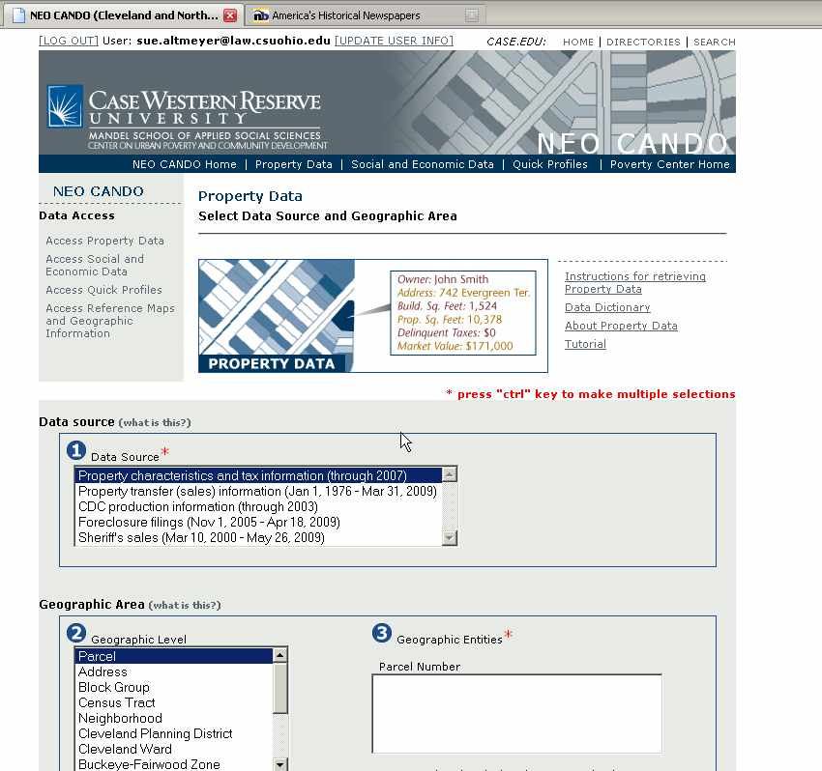

Slide 64
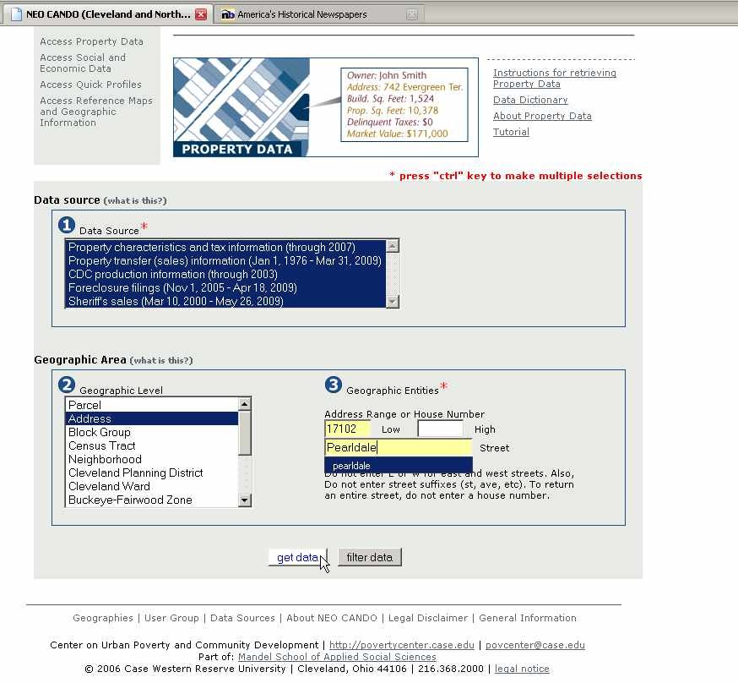

Slide 65
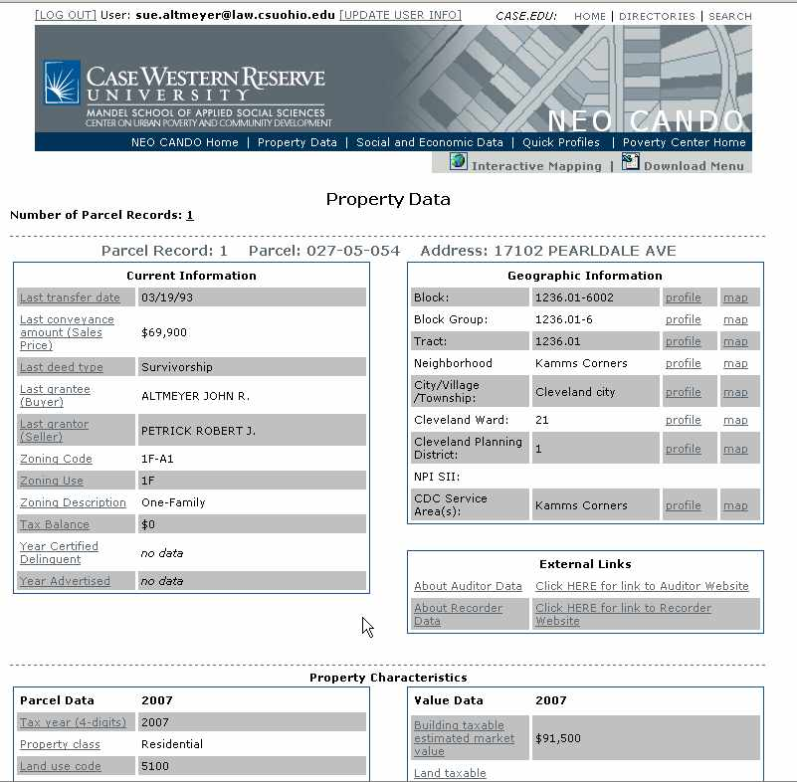

Slide 66
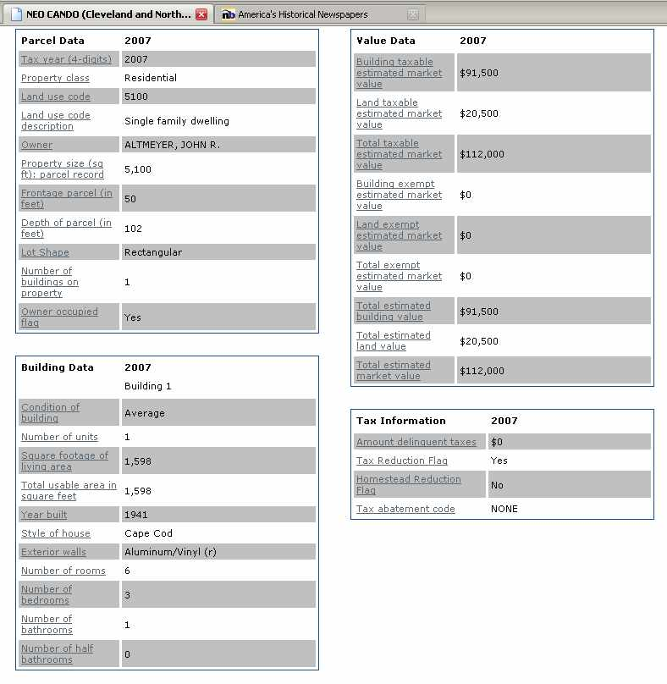

Slide 67
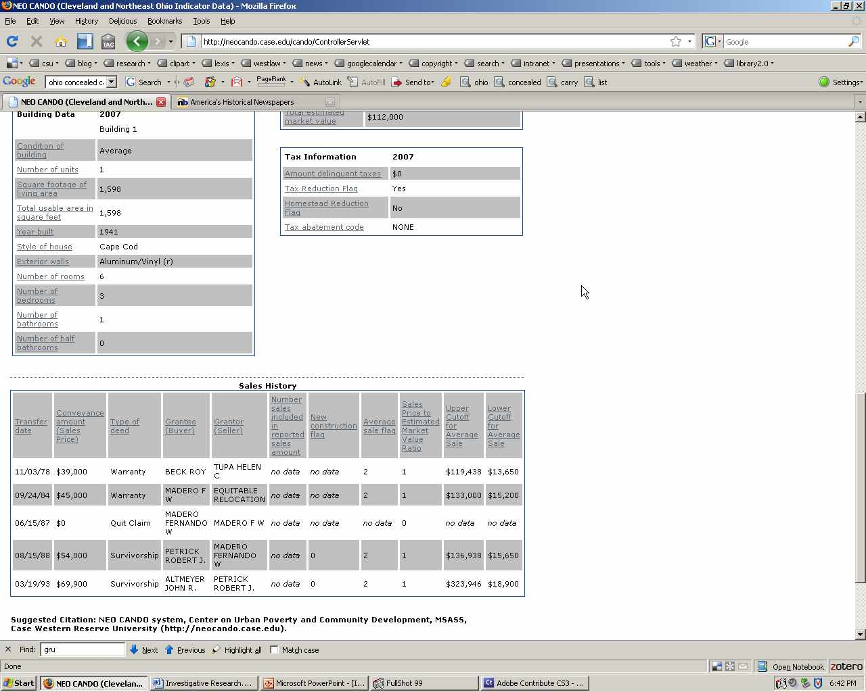

Slide 68
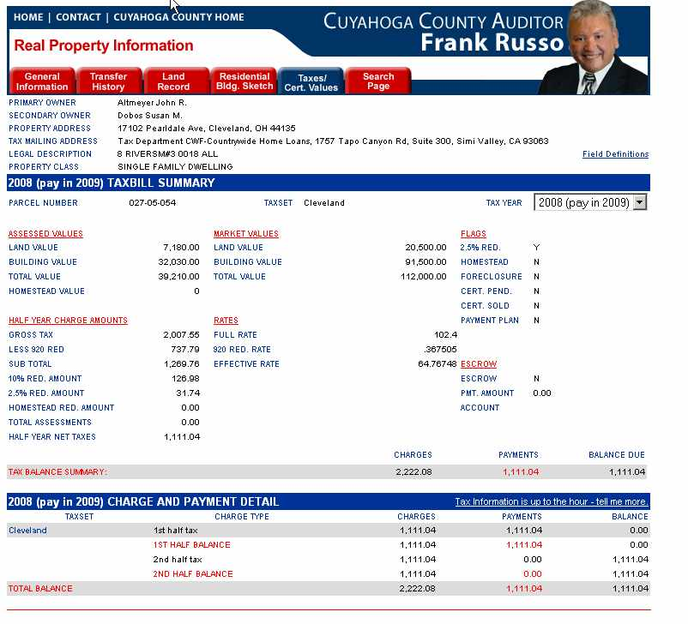

Slide 69
UCC Filings
UCC filings – Ohio Secretary of State
Searchsystems.net for UCC filings.
UCC Article 9 filings may be with county recorder.

Slide 70
Airplanes, Cars & Boats
Airplanes – Landings, Portico, Celebrity Aircraft
Boats - Portico
Ohio Department of Public Safety Online Vehicle/Watercraft Title Inquiry Boats, Autos, need VIN no. or title no.
Notes:
For automobile searches by owner name, need permissible purpose under Drivers Privacy Protection Act

Slide 71
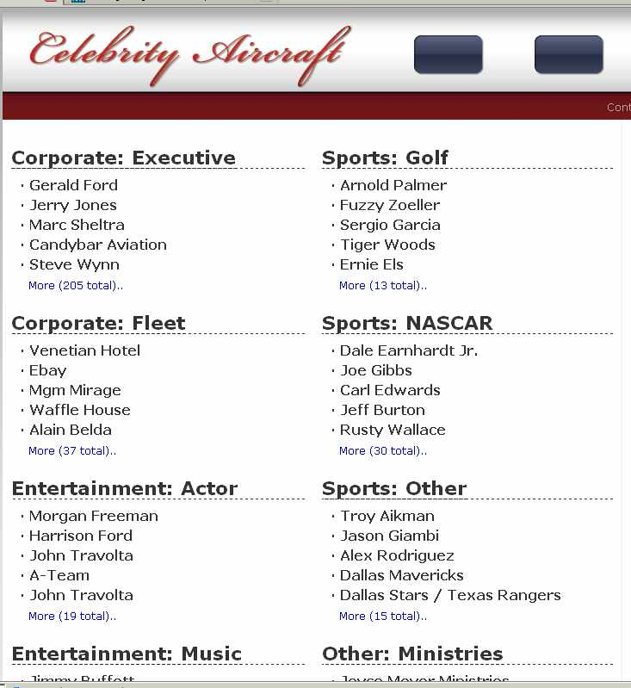

Slide 72
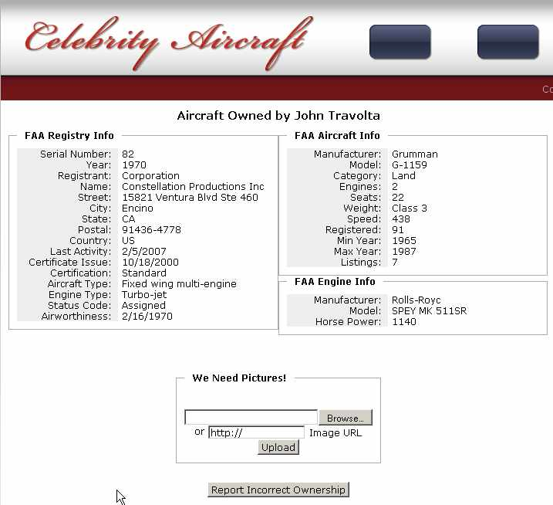

Slide 73
Stocks
Corporate insiders – officers, directors, >10% shareholders
SEC Forms 3, 4, 5 and 144
SEC’s Edgar

Slide 74
Unclaimed Funds
County Auditor or County Treasurer
Summit Count Fiscal Office Unclaimed Funds
Ohio Department of Commerce Online Treasure Hunt (to ODC after 5 years)
National Association of Unclaimed Property Administrators

